Slide 1
Challenges and Opportunities in Designing, Delivering, and Evaluating Digital Innovations for Rare Conditions
Exploring digital healthcare advances for uncommon diseases
Notes:
Good morning. Thank you for the opportunity to be here today. My name is Joshua, and this morning I'd like to discuss the challenges and opportunities I anticipate in the complex but vital field of digital innovation for rare conditions.

Slide 2
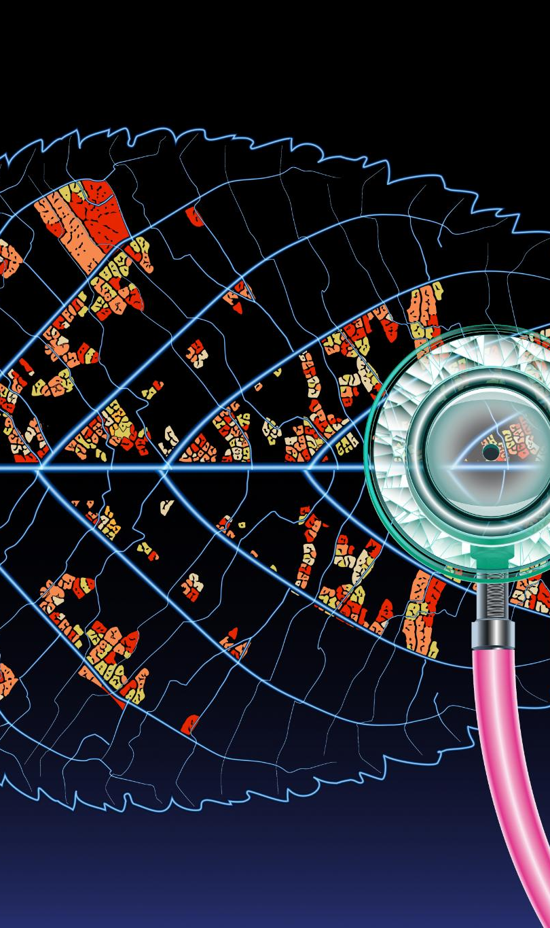
The Rare Disease Paradox
Rare Disease Paradox
Over 7,000 rare conditions affect millions collectively despite each condition's individual rarity.
Diagnostic Odyssey Challenge
Patients often face a long, frustrating journey to get an accurate rare disease diagnosis.
UK Framework Priorities
Focus is on speeding up diagnosis, raising healthcare awareness, and better care coordination for rare diseases.
Role of Digital Innovation
Digital tools are crucial enablers to achieve strategic goals and improve patient outcomes.
Notes:
The landscape of rare conditions is defined by a fundamental paradox.
While each of the 7,000-plus conditions is, by definition, rare, together they affect millions of people across the UK.
For these individuals, the path to a diagnosis is often a long and frustrating journey, aptly termed the ‘diagnostic odyssey’, which can involve years of uncertainty and misdiagnosis before an answer is found.
Recognizing this, the UK Rare Diseases Framework has set clear national priorities: to speed up diagnosis, improve awareness among healthcare professionals, and better coordinate care.
In this context, digital innovation isn't just an interesting development; it's positioned as the critical enabler to turn these strategic goals into a reality for patients.

Slide 3

From Data Silos to Integrated Intelligence
Shift from Fragmented Data
Moving away from disconnected data silos enables a unified view of patient information.
Encompass Programme Impact
Northern Ireland's encompass programme creates a single digital care record for every citizen.
Multi-Omic Data Integration
Combining genomics, epigenetics, and clinical data builds a complete patient profile.
Learning Health System Vision
Integrated data enables learning health systems for personalized medicine and accelerated research.
Notes:
The single greatest opportunity before us is a paradigm shift away from fragmented data towards integrated intelligence.
For too long, a patient's story has been scattered across several disconnected systems.
Here in Northern Ireland, the rollout of the encompass programme is a landmark step, creating a single digital care record for every citizen.
This provides a foundational clinical data backbone.
But the true potential is unlocked when we integrate this clinical data with the rich multi-omic data streams, combining genomics, epigenetics, and clinical information to build a complete picture.
This creates the blueprint for a true 'learning health system'—a dynamic feedback loop where insights from genomic sequencing can be linked to clinical outcomes in the electronic health record, allowing us to learn from every patient interaction.
A system that could identify which treatments work best for specific genetic profiles and flag individuals who may be eligible for new clinical trials, thereby accelerating both research and the delivery of personalised medicine, fulfilling the vision set out in national strategies like Genome UK.

Slide 4

Navigating the Challenge
Balancing Scale and Specificity
Data-driven technologies require large-scale data yet must address each patient's specific needs precisely.
Bridging Theory and Practice
There is a gap between new technologies' theoretical benefits and their real-world acceptance by clinicians and patients.
Ethical Collaboration and Privacy
Navigating between scientific collaboration and protecting patient confidentiality is a critical ethical challenge.
Notes:
However, this technological promise is not self-fulfilling. Its realisation depends on navigating a three-part challenge.
First, the tension between the immense scale required by data-driven technologies and the specificity of an individual patient.
Second, the gap between the theoretical potential of a new tool and the complex reality of its adoption by clinicians and patients.
And third, the ethical tightrope we must walk between the scientific need for open collaboration and the non-negotiable need for patient confidentiality.
These are not separate hurdles; they are interwoven facets of a single problem.

Slide 5

Reconciling Algorithmic Scale with Human Specificity
Big Data vs Small Data Challenge
Machine learning relies on large datasets, but rare diseases involve limited and diverse patient data, complicating analysis.
Interoperability Gap
Genomic data complexity clashes with structured electronic health records, posing major integration challenges for current systems.
Importance of Patient Experience
Datasets often miss patients' lived experiences, which are essential for developing meaningful clinical solutions.
Notes:
The first challenge is technical.
Technologies like machine learning thrive on 'big data', yet the world of rare disease is one of 'small data'—characterised by limited patient numbers and significant heterogeneity.
This makes traditional clinical trial models difficult and demands innovative analytical approaches.
Furthermore, there's a fundamental interoperability gap.
For example, electronic health records have evolved from problem-oriented medical records and are designed to store structured, deterministic data—a specific diagnosis, a blood pressure reading, a prescribed medication.
Genomic data is fundamentally different.
It is immense in scale, highly complex, and inherently probabilistic—it speaks in terms of risk and predisposition, not certainty.
Forcing this vast, uncertain data into a deterministic framework is a formidable architectural challenge that current systems are simply not built to handle.
Crucially, even the most complete dataset often misses the most important information: the patient's lived experience, which is vital for creating solutions that are truly meaningful and reflect the day-to-day reality of their condition.

Slide 6

Bridging Technological Potential with Clinical Reality
Patient Digital Divide
Patients face barriers like low digital literacy and lack of user-centered design, creating a digital divide.
Community Co-design
Involving users early through community co-design improves adoption and relevance of healthcare technologies.
Clinician Workflow Integration
Clinicians resist tools disrupting workflows; technology must fit seamlessly into clinical practice.
Change Management Focus
Successful implementation requires addressing change management, not just technology deployment.
Notes:
The second challenge is socio-technical. A perfect algorithm is useless if it's not used.
For patients, a 'digital divide' exists, created by barriers like low digital literacy or tools that aren't designed with their input.
The solution here is a move towards community co-design, involving users from the very beginning.
This goes beyond simple usability testing to ensure that tools are not just easy to use, but also culturally relevant and trustworthy for the diverse communities they aim to serve.
For clinicians, the barriers are just as significant.
They operate in high-pressure, time-constrained environments.
Their resistance is often not a simple reluctance to change, but a rational cost-benefit analysis where the perceived effort of learning and integrating a new system—one that might disrupt finely-tuned workflows or increase administrative burden—outweighs its perceived, and often unproven, clinical value.
Successful implementation is therefore a change management problem, not just a technology deployment problem.
We must ask not only 'does it work?', but 'how does it fit into the work of the clinic and the life of the patient?

Slide 7

Balancing Open Collaboration with Patient Confidentiality
Ethical Data Sharing Challenges
Sharing genomic data is vital for research but poses unique ethical challenges due to identifiability and family privacy concerns.
Trusted Research Environments
Using secure environments allows data analysis without moving sensitive information, ensuring privacy and compliance.
Dynamic Patient Consent
Moving from one-time to ongoing consent models empowers patients as active partners in research decisions.
Building Public Trust
Maintaining public trust through transparency and governance is essential for future research progress.
Notes:
The final challenge is ethical.
Progress in rare disease research is dependent on pooling data globally.
Yet, the very data we need to share—a person's genome—is also uniquely identifiable.
Unlike other medical data, it can never be truly and irreversibly anonymised.
This creates a profound ethical dilemma because genomic data is familial.
An individual's genome contains sensitive, predictive health information not only about them but also about their parents, their children, and even future descendants—none of whom have consented to this disclosure.
"The path forward lies in robust governance.
This includes using Trusted Research Environments, where the data remains stationary and highly secure, and approved researchers are given access to analyse it.
This model fundamentally changes the paradigm from 'data sharing' to 'data access’.
It must also be coupled with an evolution towards dynamic consent, treating it as an ongoing process, not a one-time event, thereby empowering patients as active partners in research.
Ultimately, earning and maintaining public trust is the bedrock of all future progress.

Slide 8

A Trajectory for Future Research
Integrated Socio-Technical Systems
Future research must focus on building integrated socio-technical systems beyond isolated digital tools.
Interdisciplinary Analytical Methods
Novel analytical methods for small data and interdisciplinary approaches are essential for future innovation.
Co-design and Ethical Governance
Embedding co-design principles and robust ethical governance is critical to develop inclusive digital tools.
Bridging Algorithm and Clinic
Developing frameworks to integrate patient experience bridges the gap between algorithms and clinical reality.
Notes:
In conclusion, the challenge is to move beyond creating isolated digital tools and instead focus on architecting integrated socio-technical systems.
This requires a truly interdisciplinary approach, one that develops novel analytical methods for small data, embeds the principles of co-design at its core, and is built upon a robust foundation of ethical governance.
A prospective PhD project, such as the one on offer here, is perfectly positioned to make a significant contribution by tackling a critical piece of this complex puzzle.
For instance, by focusing on developing and validating a framework for co-designing digital tools that effectively capture and integrate the patient's experience,
a project can directly address the critical gap between algorithmic potential and clinical reality, ensuring that the solutions we build are not just technically elegant, but human-centred and truly impactful.
By addressing these fundamental challenges, we can help translate the immense promise of digital innovation into tangible, and lasting benefits.

Slide 9

Thank You & Questions
Notes:
Thank you for your time and attention. I would be delighted to answer any questions you may have.

Slide 10
Reference List
Rare Disease UK. The Rare Reality: An insight into the patient and family experience of rare disease. 2020.
Department of Health and Social Care. The UK Rare Diseases Framework. 2021.
Eurodis. The Voice of 12,000 Patients: Experiences and Expectations of People Living with a Rare Disease. 2019.
Nguengang Wakap, S., et al. Estimating cumulative point prevalence of rare diseases: analysis of the Orphanet database. European Journal of Human Genetics. 2020.
Department of Health Northern Ireland. Northern Ireland Rare Diseases Action Plan 2022/23. 2022.
Department of Health and Social Care. England Rare Diseases Action Plan 2023: Main Report. 2023.
Digital Health and Social Care NI. encompass. [Online].
nidirect Government Services. View your medical records online using My Care. [Online].
Queen's University Belfast. Centre for Public Health. [Online].
McKnight, A.J. Professor Amy Jayne McKnight Profile. Queen's University Belfast. [Online].
Hill, C., et al. Harnessing the Full Potential of Multi-Omic Analyses to Advance the Study and Treatment of Chronic Kidney Disease. Frontiers in Nephrology. 2022.
Department of Health and Social Care. Genome UK: the future of healthcare. 2020.
Department of Health and Social Care. Genome UK: 2022 to 2025 implementation plan for England. 2022.
Department of Health and Social Care. Genome UK: shared commitments for UK-wide implementation 2022 to 2025. 2022.
Schork, N.J. Artificial Intelligence and Big Data in Rare Diseases. Circulation. 2019.
Glicksberg, B.S., et al. Challenges and opportunities for clinical trials in rare and orphan diseases. Journal of Translational Medicine. 2021.
HITLAB. The Future of Rare Disease Care Innovation. 2025.
Kho, A.N., et al. Practical challenges in integrating genomic data into the electronic health record. Genetics in Medicine. 2013.
Ashley, E.A. Towards precision medicine. Nature Reviews Genetics. 2016.
Weed, L.L. Medical records that guide and teach. New England Journal of Medicine. 1968.
Hersh, W.R. The electronic health record: a transformative technology. JAMA. 2009.
Warner, J.L., et al. Electronic Health Records and Genomics: Perspectives from the Association for Molecular Pathology. The Journal of Molecular Diagnostics. 2019.
Basch, E. The missing voice of patients in drug-safety reporting. New England Journal of Medicine. 2010.
California Health Care Foundation. Bridging the Digital Divide: A Guide for Designers of Digital Health Tools. 2022.
Lyles, C.R., et al. The Digital Divide and Patient Portals: A Mixed-Methods Study of Patient-Provider Differences in Portal Use. Journal of Medical Internet Research. 2020.
Ni, Z., et al. A Human-Centered Design Framework for Digital Health Solutions. JMIR mHealth and uHealth. 2023.
Bjerkan, J., et al. A review of design and evaluation practices in participatory design. International Journal of Human-Computer Studies. 2021.
Cresswell, K., & Sheikh, A. Organizational issues in the implementation and adoption of health information technology innovations: an interpretative review. International Journal of Medical Informatics. 2013.
Gagnon, M.P., et al. A systematic review of factors influencing the adoption of information and communication technologies by healthcare professionals. Journal of Medical Systems. 2012.
Hepburn, J., et al. Barriers and facilitators to digital health technology adoption by older adults with chronic disease. British Journal of General Practice. 2025.
Granja, C., et al. Factors Determining the Success and Failure of eHealth Interventions: Systematic Review of the Literature. Journal of Medical Internet Research. 2018.
Mair, F.S., et al. Understanding the implementation and integration of e-health services. Journal of Telemedicine and Telecare. 2012.
Erlich, Y., & Narayanan, A. Routes for breaching and protecting genetic privacy. Nature Reviews Genetics. 2014.
Phillips, M. Can genomic data be anonymised? Global Alliance for Genomics and Health. 2019.
National Human Genome Research Institute. Privacy in Genomics. [Online].
General Data Protection Regulation (GDPR). Regulation (EU) 2016/679.
Vayena, E., & Tasioulas, J. The ethics of big data in health care. Big Data & Society. 2016.
Ritchie, F., & Elliot, M. Principles of and practice in secure research environments. Annual Review of Statistics and Its Application. 2015.
Genomics England. Newborns Programme: Ethics. [Online]

